Slide 1
Subject: VISUAL ARTS
Term: FIRST TERM
Session : 2023/2024
Class : GRADE NINE
Educator: Mr. SHOTOMIDE OLAOYE

Slide 2
WEEK 1:
REVISION OF PREVIOUS CLASS TOPICS
INTRODUCTION TO CRAFT MAKING
WEEK 2
WEEK 3:
KNITTING CRAFT
INTRODUCTION TO CROCHETING
WEEK 4
WEEK 5:
INTRODUCTION TO MACRAME CRAFT
SOFT TOY MAKING
WEEK 6
WEEK 7:
MID-TERM BREAK
EMBROIDERY DESIGN
WEEK 8
WEEK 9:
LOCAL CRAFT BUSINESS
NIGERIA CONTEMPORARY ARTISTS
WEEK 10
WEEK 11:
REVISION
EXAMINATION
WEEK 12

Slide 3
AT THE END OF THIS LESSON, STUDENTS SHOULD BE ABLE TO;
State some of the topics from their last class,
Explain some of the topics they can remember and
State some art materials and tools.
REVISION OF PREVIOUS CLASS TOPICS
INFLUENCE, INTERACTION, DRAMATISTS, LYRICS, PATRIOTISM, CUSTOM, ETHIC AND UNITY.

Slide 4
REVISION
Another name for art material is art medium.
It is a substance used by an artist to create a work of art.

Slide 5
REVISION
Fabrics
Charcoal
Paint
Papers
Crayon
Dye stuff
Caustic soda
Sulphur
Candle wax
wood
Textile ink
Canvass
Fixative
Beads
Clay
Plasticine
Starch
Paper tape
Poster colour
Acrylic paint etc.

Slide 6
Evaluation one
Question 1
What is art material?
Question 2
Mention at least five art materials.

Slide 7
REVISION
An art tool can be defined as an object, device, equipment or vehicle that is used to transport or transform the art material or medium into creating a finished work of art.

Slide 8
REVISION
Mallets
Hammer
Chisel
Throwing wheel
Paint brushes
Cutting knives
Pliers
Easel stands
Tjanting
Mesh
Squeegee
Caliper
Scrapper
Scooper
Clipper Etc.

Slide 9
REVISION
Question 3
What art tools?
Question 4
List seven art tools.

Slide 10

Any Questions?

Slide 11
AT THE END OF THIS LESSON, STUDENTS SHOULD BE ABLE TO;
Define craft making,
State some types of craft making and
Produce a still-life drawing of an object in their sketch pad.
Introduction to CRAFT MAKING
SHADING, TONAL GRADUATION, CHAIROSCURO, SKETCH, PROPORTION, COMPOSITION, PERSPECTIVE AND BALANCE.

Slide 12
MEANING OF CRAFT
Craft making is simply the art of creating things with locally source materials using hand.

Slide 13
TYPES OF CRAFT MAKING
MEANING OF CRAFT
knitting
Paper craft
carving
embroidery
Hat making
Bead making
Pottery
Tie-dying
Leather work
Basket making
Mat weaving
batik
Papier mache
etc.

Slide 14
Evaluation one
Question 1
What is craft making?
Question 2
Mention four types of craft making.

Slide 15
FUNCTIONS OF CRAFT MAKING
MEANING OF CRAFT
Craft making is used for decoration
It is used for recycling
It is used for creating jobs
It is used for domestic purposes
It is also used for promoting creativity
And many more.

Slide 16
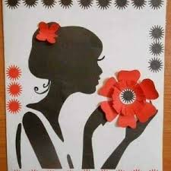
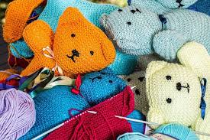
MEANING OF CRAFT

Slide 17
Evaluation one
Question 3
What is still-life drawing?
Question 4
Draw and shade the drawing from the screen

Slide 18
Any Questions?

Slide 19
TOPIC: INTRODUCTION TO KNITTING CRAFT
AT THE END OF THIS LESSON, STUDENTS SHOULD BE ABLE TO;
Define knitting craft,
List some materials and tools needed for knitting and
Produce a still-life drawing of an object in their sketch pad.
Introduction to KNITTING CRAFT
SHADING, TONAL GRADUATION, CHAIROSCURO, SKETCH, PROPORTION, COMPOSITION, PERSPECTIVE AND BALANCE.

Slide 20
TOPIC: MEANING OF KNITTING CRAFT
Knitting is the act of making clothes, from wool or cotton thread using two long knitting needles or a knitting machine.
It is the process of constructing clothing material using pin to form series of interlocking loops like chain.

Slide 21
Materials and tools used in knitting
Wool or cotton thread
Long needle
Knitting machine
Pins.

Slide 22
TOPIC: class work>> Evaluation one
Question 1
What is knitting craft?
Question 2
Mention three materials for knitting.

Slide 23
Terms used in knitting
Hand-knitting: it is done by producing interlocking loops in a weft-wise direction.
Machine knitting: it produces fabric on warp knitting.
Warp: The thread on the loom that other threads are passed over and under in order to make the cloth.

Slide 24
4. Weft: The threads that are twisted under and over the threads that are held on a loom.
4. Wool: the long thick thread made from animal’s back, used for knitting.
6. Interlocking: fitting or fastening together; a weaving system.
7. loop: A shape like a curve or circle made by a linen curving right crossing itself.

Slide 25
TOPIC: class work>> Evaluation two
Question 3
State four terms in knitting.
Question 4
Explain the meaning of any three.

Slide 26
Any Questions?

Slide 27
TOPIC: INTRODUCTION TO CROCHETING
AT THE END OF THIS LESSON, STUDENTS SHOULD BE ABLE TO;
Define crocheting,
State the three basic stitching techniques in crocheting and
State some of the materials for crocheting.
Introduction to CROCHETING
HOME PAGE
LOOP, BAGS, SHAWLS, CAPS, TABLEMAT, WOOL, YARN, COTTON AND NEEDLE.

Slide 28
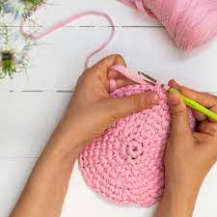
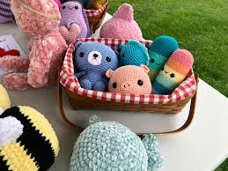
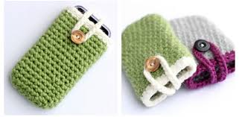
CROCHETING
This is A method by which A fabric formed with A single thread and hook. The word ‘crochet’ is derived from the French word ‘kro-shay’ meaning ‘hook’.
Crochet was traditionally used to make lacy patterns for doilies and edgings.
Nowadays, with modern designs, it is used to make a variety of articles both for personal and household use.
Examples of these are; bags, shawls, caps, tablemat etc.

Slide 29
MATERIALS AND TOOLS
Balls of wool
A tape measure
3. Size 2 crochet hook
4. A small bag to keep equipment clean
5. A small pair of scissors
6. A needle with a blunt point.

Slide 30
TOPIC: class work>> Evaluation one
Question 1
What is crocheting?
Question 2
Mention three materials for crocheting.

Slide 31
BASIC STITCHES IN CROCHETING
Chain stitches: chain stitches are fold over the wool to make A loop. Place the wool under and across loop. Pick up the wool that has just been placed across the loop with the crochet hook. Draw it up, tighten the knot by pulling the strand wool on the right.. This knot and the loop attached are used as a starting stitch. Other loops are made and linked together, one on top of another. These loops are called chain stitches, and these stitches are the beginning of crochet work.

Slide 32
Treble stitches: these are useful stitches in crochet. It is done from right to left. Make twenty chain stitches passing the wool over and under the hook. Miss two chain and insert the hook in the third chain stitch. Pass the wool over and under the hook. Catch the wool and draw it through the hook. There are now three loops on the hook. Pass the wool over and under the hook. Catch the wool and draw it through the remaining two loops. Repeat this stitch by working in all the remaining chain stitches.
Slip stitch: this basic stitch is used for joining borders and as a finishing edge. With one loop on the hook, hook under next stitch, catch yarn and pull loop through stitch and loop on loop in one movement.

Slide 33
TOPIC: class work>> Evaluation two
Question 1
State the three basic stitching in crocheting?
Question 2
Explain two of them.

Slide 34
Any Questions?

Slide 35
TOPIC: INTRODUCTION TO MACRAME
AT THE END OF THIS LESSON, STUDENTS SHOULD BE ABLE TO;
Define macramé design,
State types of macramé design in art and
List all the patterns in macramé design.
Introduction to MACRAME DESIGN
HOME PAGE
WOOL, YARN, SCISSORS, WARP, WEFT, COARSE, LACING AND INTERWOVEN.

Slide 36
Macramé is a type of ornamental work made by knotting and weaving coarse thread into a pattern.

Slide 37
MATERIALS AND TOOL
Metal Ring
Cotton or plastic rope
Beads
Wooden frame
Dye (optional)
Knife
Lighter
Matches

Slide 38
TOPIC: class work>> Evaluation one
Question 1
What is macramé?
Question 2
Mention four materials for creating a macramé craft.

Slide 39
Basic types of macramé craft
The square knot
The spiral knot and
The half-hitch knot.

Slide 40
PATTERN
These are ornamented designs created from various motifs in repeated manner to achieve unit, harmony and balance. The following are some of the existing types of Patterns in macramé
Diamond
X-pattern
Triangle

Slide 41
TOPIC: class work>> Evaluation two
Question 1
State the basic types of macramé craft?
Question 2
Mention the three patterns in macramé craft.

Slide 42
Any Questions?

Slide 43
TOPIC: INTRODUCTION TO SOFT TOY MAKING
AT THE END OF THIS LESSON, STUDENTS SHOULD BE ABLE TO;
Define soft toy,
Mention some of the materials for soft toy making and
List some functions of soft toys.
Introduction to SOFT Toy making
HOME PAGE
LANDSCAPE, EYE-LEVEL, ILLUSION, AERIAL, BACKGROUND, FOREGROUND, LINE OF VISION AND VANISHING POINT.

Slide 44
SOFT TOY MAKING
Soft toys are toys that are made of cloth filled with a soft material and which look like animals.

Slide 45
Materials and Tools for Making Soft Toys
Woodley fabric
Towel fabric
Needles
Measuring tape
Brown paper
Stiffing (cotton, feather foam)
Specimen of different types of stitches
Specimen of seams
Sewing machine

Slide 46
TOPIC: class work>> Evaluation one
Question 1
Define soft toy.
Question 2
Mention three materials for soft toys.

Slide 47
STITCHES IN TOY MAKING
All stitches used in Toy making come under permanent stitches: Permanent stitches are stitches used to permanent or finally hold the different pieces of cut out materials together. Stitches used in toy making include
  Back Stitches
  Over- sewing stitches
  Machine stitches
  Stab stitches
  ladder stitches
  Decorative stitches.

Slide 48
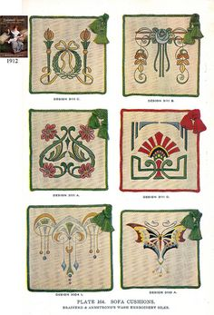
STITCHES IN TOY MAKING
Back Stitches: these are methods of sewing in which each stitch begins in the middle of the previous one.
Over - Sewing: This is used to join two edges together or two folded edges of a materials.
Machine Stitches: This is worked with machine and it holds the pieces of cut - out materials in position.
Decorative stitches: These are stitches used to put designs on clothes. Some can actually be used to finish some edges, examples include: whipped stitches, stem, satin, zigzag, French knot herring – borne, feather, x stitches etc.

Slide 49
TOPIC: class work>> Evaluation two
Question 1
List three stitch method in soft toy making.
Question 2
Explain two of them.

Slide 50
Any Questions?

Slide 51
TOPIC: INTRODUCTION TO EMBROIDERY
AT THE END OF THIS LESSON, STUDENTS SHOULD BE ABLE TO;
Define embroidery ,
Mention some materials for embroidery and
List some sources of creating an embroidery design
Introduction to EMBROIDERY
HOME PAGE
PRINTING, SQUEEGEE, CHROME, MESH, PRODU, COMPOSITION, PERSPECTIVE AND BALANCE.

Slide 52
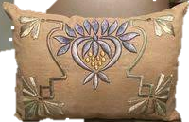
TOPIC: MEANING OF EMBROIDERY
INTRODUCTION TO EMBROIDERY
Embroidery is the art of using ordinary hands to create an ornamental designs with needle and thread or electrical/manual embroidery machine on textile materials.

Slide 53
MATERIALS FOR EMBROIDERY
Materials for embroidery include,
Needles of different sizes
Brown paper for initial practice
Various types of threads in different colors, beads, skin leather, cloth materials
Finally a sophisticated embroidery machine which makes embroidery machine work easier and faster.

Slide 54
TOPIC: class work>> Evaluation one
Question 1
Define embroidery design?
Question 2
State three material for embroidery.

Slide 55
EMBROIDERY TOOLS & FACILITIES
Threads of various colors and brands
Imported dye
stay- - fabric.
4. Starch
5. Twine
6. Needle (different sizes)
7. Electric Iron
8. Weaving machine

Slide 56
SOURCES OF EMBROIDERY DESIGN
Nature
Environmental designed
Floral
Trees
Magazine & Newspaper
Gift wrappers

Slide 57
TOPIC: class work>> Evaluation two
Question 1
List some tools needed in embroidery design.
Question 2
State three sources of embroidery design.

Slide 58
Any Questions?

Slide 59
TOPIC: INTRODUCTION TO LOCAL CRAFT BUSINESS
AT THE END OF THIS LESSON, STUDENTS SHOULD BE ABLE TO;
Define local craft business,
Mention some types of local craft business and
State some characteristic of Local Craft business Owner.
Introduction to LOCAL CRAFT BUSINESS
HOME PAGE
BATIK, POTTERY, EMBROIDERY, CROCHETING, WARP, STITCHES, YARN, KNITTING AND CANE.

Slide 60
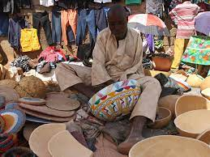
LOCAL CRAFT BUSINESS
Local craft business deals with the production, buying and selling of art and craft works.

Slide 61
Fabric Decoration
Soft toy making
Weaving
Pottery
Carving
Leather work
Metal work
Bead work
Types of Local Craft Business

Slide 62
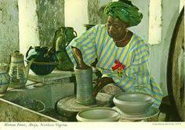
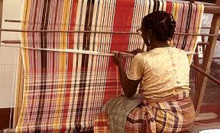
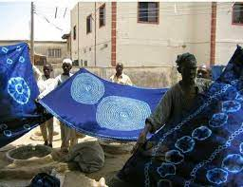
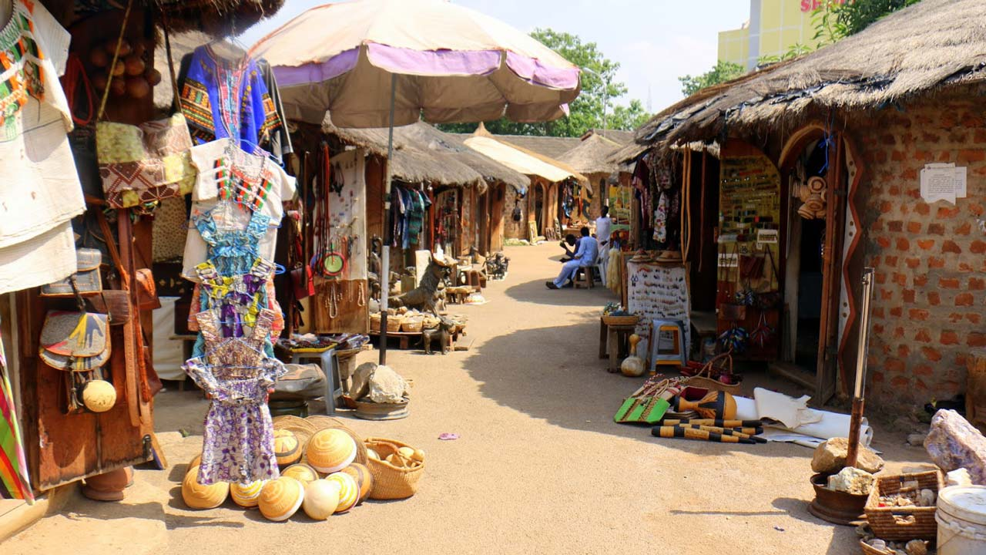
Fabric Decoration: it is a local craft business that involves the production, buying and selling of clothing materials, such as tie and dye, batik etc.
Soft toy making: this is a local craft business of making harmless objects that children play with e.g. teddy bear, ragdoll.
Weaving: weaving is a process of interlacing the reds or fiber usually at right angles e.g. mat weaving, cloth sewing.

Slide 63
Pottery: this is the art of making pots and other related objects e.g. flower vases, ash – trays, tea cups and saucers mugs, with clay molded.
Carving: it is a process by which some area of solid piece of material is cut away or chipped off to create a new form i.e. wood, calabash, stone, ivory, rubber stamps.
Leather work: Leather crafting or simply leather craft is the practice of making leather into craft objects or works of art, using shaping techniques, coloring techniques or both. Leather products may include shoe, bags, hats, drums etc.

Slide 64
TOPIC: class work>> Evaluation one
Question 1
Define local craft business.
Question 2
Mention four local craft business.

Slide 65
CHARACTERISTIC OF LOCAL CRAFT BUSINESS OWNER
ABILITY TO TAKE RISK: a local craft business owner should be able to venture into a business without doubling what could be its outcome at the end of the day.
ABILITY TO WORK LONG HOURS: as a local craft business owners you should be able to work for long or many hours. This will help you to meet up with your targets.
ABILITY TO WORK HARDER TO MEET DEADLINE: since you have imbibed the habit of working for long hours. It shows that you can work hard. Therefore, you should be able to work hard to meet deadline.

Slide 66
BE INNOVATIVE: a local craft business owner should be able to introduce new ideas into the business. This help to boost the business and brings more profit in return.
ABILITY TO MAKE DECISION: as a local craft business owner one should be able to decide on his or her own about strategies that he or she believes can make the business grow and bring more profits.
CREATIVITY: a local craft business must be creative enough to always produce or make his business indistinctive way so as to confront any situation.

Slide 67
TOPIC: class work>> Evaluation two
Question 3
Explain three local business you understand from today‘s lesson.
Question 4
Mention four characteristics of a local craft business owner.

Slide 68
Any Questions?

Slide 69
TOPIC: CONTEMPORARY ARTISTS AND THEIR DATES
AT THE END OF THIS LESSON, STUDENTS SHOULD BE ABLE TO;
Define contemporary art,
Mention some contemporary artists in Nigeria and
State some of their art works.
CONTEMPORARY ARTISTS IN NIGERIA
HOME PAGE
BATIK, POTTERY, EMBROIDERY, CROCHETING, WARP, STITCHES, YARN, KNITTING AND CANE.

Slide 70
Contemporary art is the art of today, produced in the second half of the 20th century or in the 21st century. The artists of this period are regarded as the pioneers in the various fields of arts in Nigeria. Contemporary art means modern.

Slide 71
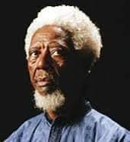
SOME CONTEMPORARY ARTISTS IN NIGERIA.
Aina Onabolu: he was born in the year 1882. (Art educator & Painter)
He was the first Nigerian artist and he had no formal training in art at the beginning of his career. He started to practice art in 1890 during which he mastered the subject of painting landscape and portrait painting. In 1920, when he went to England and Paris to study art, he returned with the knowledge of painting. He was the first Nigerian trained artist to teach art in school. Onabolu was an accomplished portrait and he was the one who produced the portrait of Rt. Rev. O. Oluwole who was cold in dark – blue red and white vestment putting his right hand on the Bible. Onabolu’s philosophical belief was that art as a universal human language which goes beyond ethnic and cultural barriers . Chief Aina Onabolu, died in 1963.

Slide 72
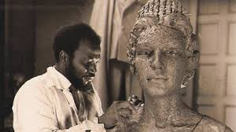
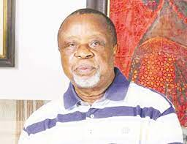
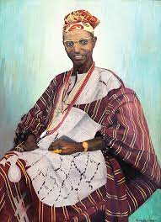
Akinola Lasekan 1916-1972 (painter and cartoonist)
Prof. Jimoh Akolo 1935 (Painter & Art Educator)
Prof. Benedict Enwonwu 1921-1994(Painter ands Sculptor)
Mrs. Etso Ugbodaga – Ngu 1921-1996(Painter and Art educator)
Dr (Mrs) ladi Kwali 1924-1984 (Potter,)
Profs. Uche Okeke 1933-2016 (Painter & Sculptor,)
Demas Nwoko 1935 (Painter, Sculptor, Architect, Costume / stage designer
Kolade Oshinowo 1948 (Painter)
Dele Jegede 1945 (Painter, Cartoonist, Art Critic)
Prof. Benedict Enwonwu 1921-1994(Painter and Sculptor)
Akinola Lasekan 1916-1972 (painter and cartoonist)
Kolade Oshinowo 1948 (Painter)

Slide 73
TOPIC: class work>> Evaluation two
Question 3
Write a very brief biography of the following contemporary artists:
Yusuf Grillo
Demas Nwoko
Jimoh Buraimoh
Professor Benedict Enwonwu

Slide 74
Any Questions?

